Slide 1



Slide 2

Introduction
Nucleus Concept
System Features
Future Development

Slide 3
What is
A N I M A P ?
A interactively location-based social website can simultaneously
handle the need of civilian using and disaster preventive .
Notes:
適地性基於位置的服務
最大的不同ANIMAP基於位置，一般基於帳號

Slide 4
What is
Location-based service?
Integrate multiple technologies of GPS location, mobile communication and navigation to provide civilian the service of spatial location .
Notes:
適地性基於位置的服務
最大的不同ANIMAP基於位置，一般基於帳號

Slide 5
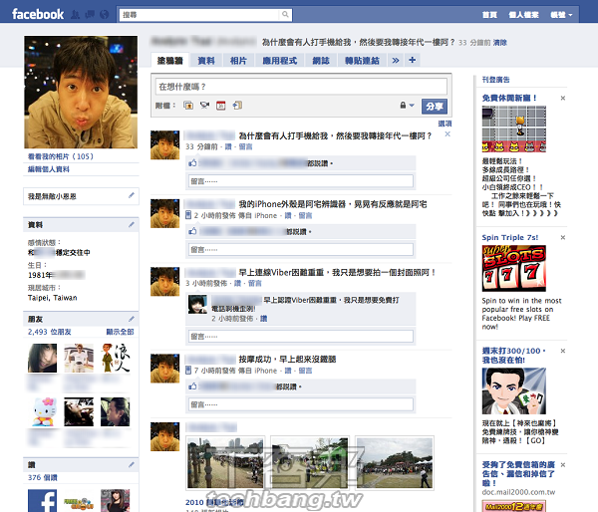
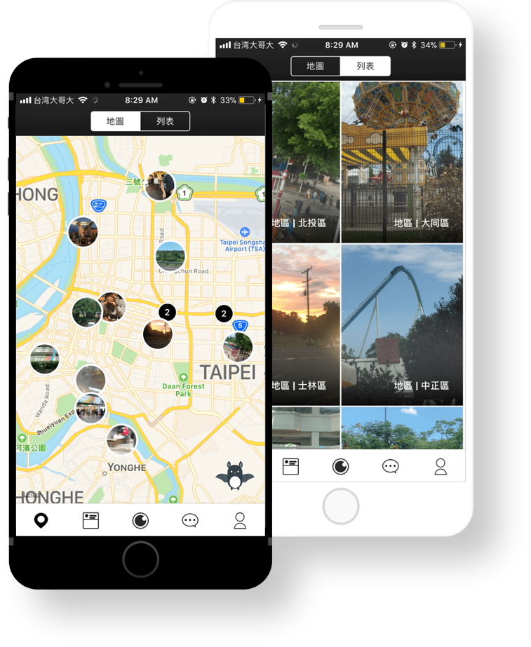

Traditional Website V.S. ANIMAP
 | Traditional Website | ANIMAP
Posts Source | Friends | Area
Location-based Service | Weak | Intense
Example | Facebook | ANIMAP
Your location
The posts nearby you
Notes:
1. Traditional website presents a lot
of friends’ posts,but it won’t present the surroundings nearby their areas.
So that is weak of Location-based service
2. This application can present the posts surrounding us by map , so ANIMAP includes more Location-based service function

Slide 6










When we use the traditional website
Run!!!!!!!
It’s gas explosion!!!!!!!
Where is the gas explosion?
It’s terrified!
But…it’s not my business.
Gas explosion!!!!!!!
So dangerous!
It’s gas explosion!
Gas explosion!!!!!!!Run!!!!

Slide 7

If we have ANIMAP…
There is a gas explosion nearby .
Run!!!!!!!!!

Slide 8
Because of ANIMAP,
We can get the news immediately.
I can prevent from the disaster.
Notes:
BECAUSE WE found the traditional website can’t bring us reality help,so we creat ANIMAP to revent from the disaster

Slide 9
Introduction
Nucleus Concept
System Features
Future Development

Slide 10
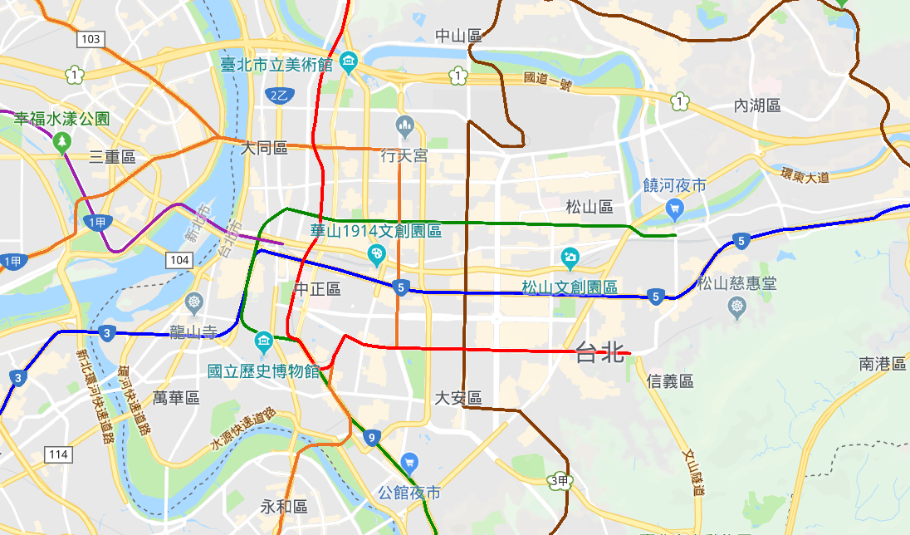


ANIMAP - Nucleus Concept
Geofencing : Defined as the user center, which could receive information
within a fixed range.
Reduce the processor’s loading
Users can focus on specific posts surrounding them
B
A
Notes:
地理柵欄的定義為，以使用者為中心，接收到固定範圍內的資訊。
例如:當使用者在a點時，會接讀取a點附近的影片內容；當使用者來到b點將會讀取到B點附近的影片內容。
Reduce the processor’s loading，focus on specific posts

Slide 11
Introduction
Nucleus Concept
System Features
Future Development

Slide 12
System Features
Civilian Notification
Emergency Notification
Vedio Sticker Edittion
Instant Vedio Map
Relative Organization
Personal Achievement

Slide 13
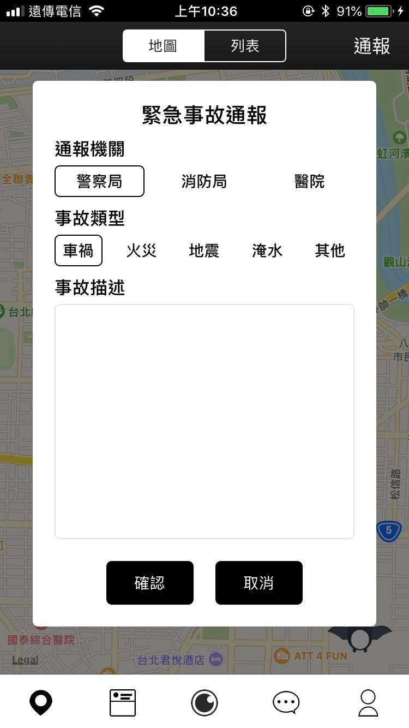
System Features
- Civilian Notification
Correctly
Directly
Efficiently
Notes:
We give some choices to choose,so that
civilian can notice more effectively

Slide 14
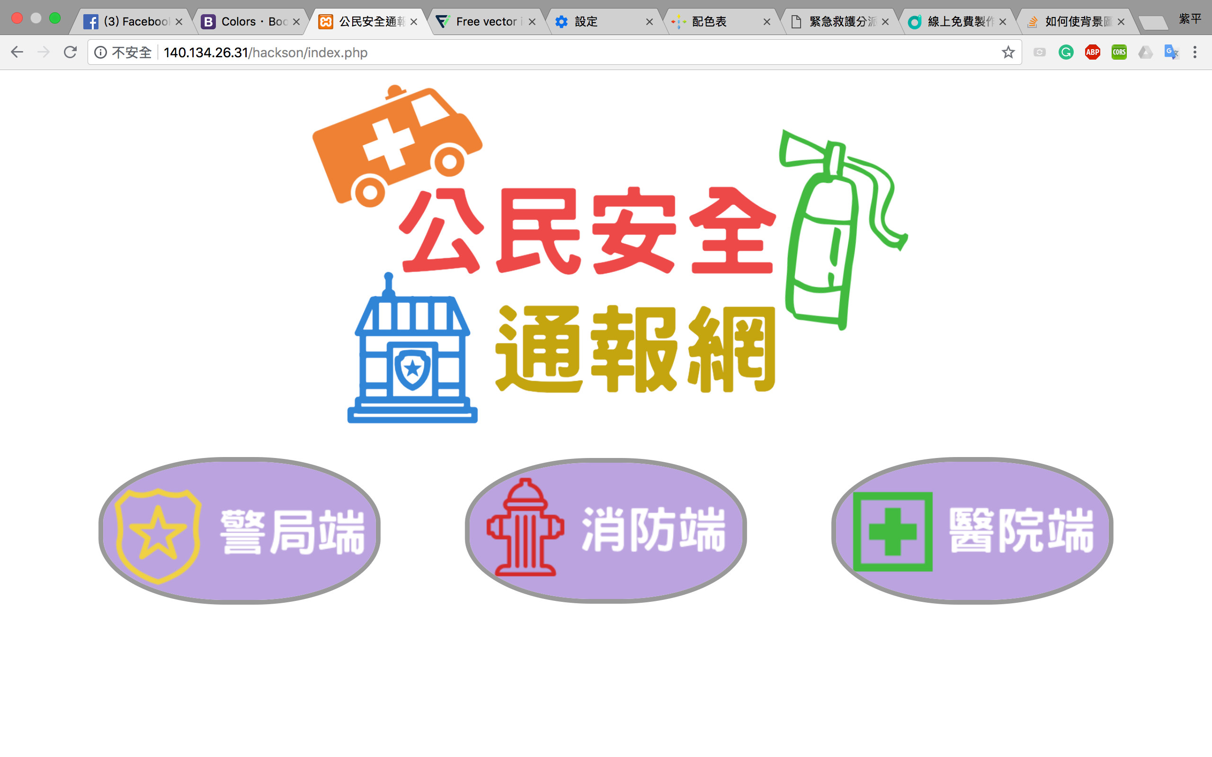
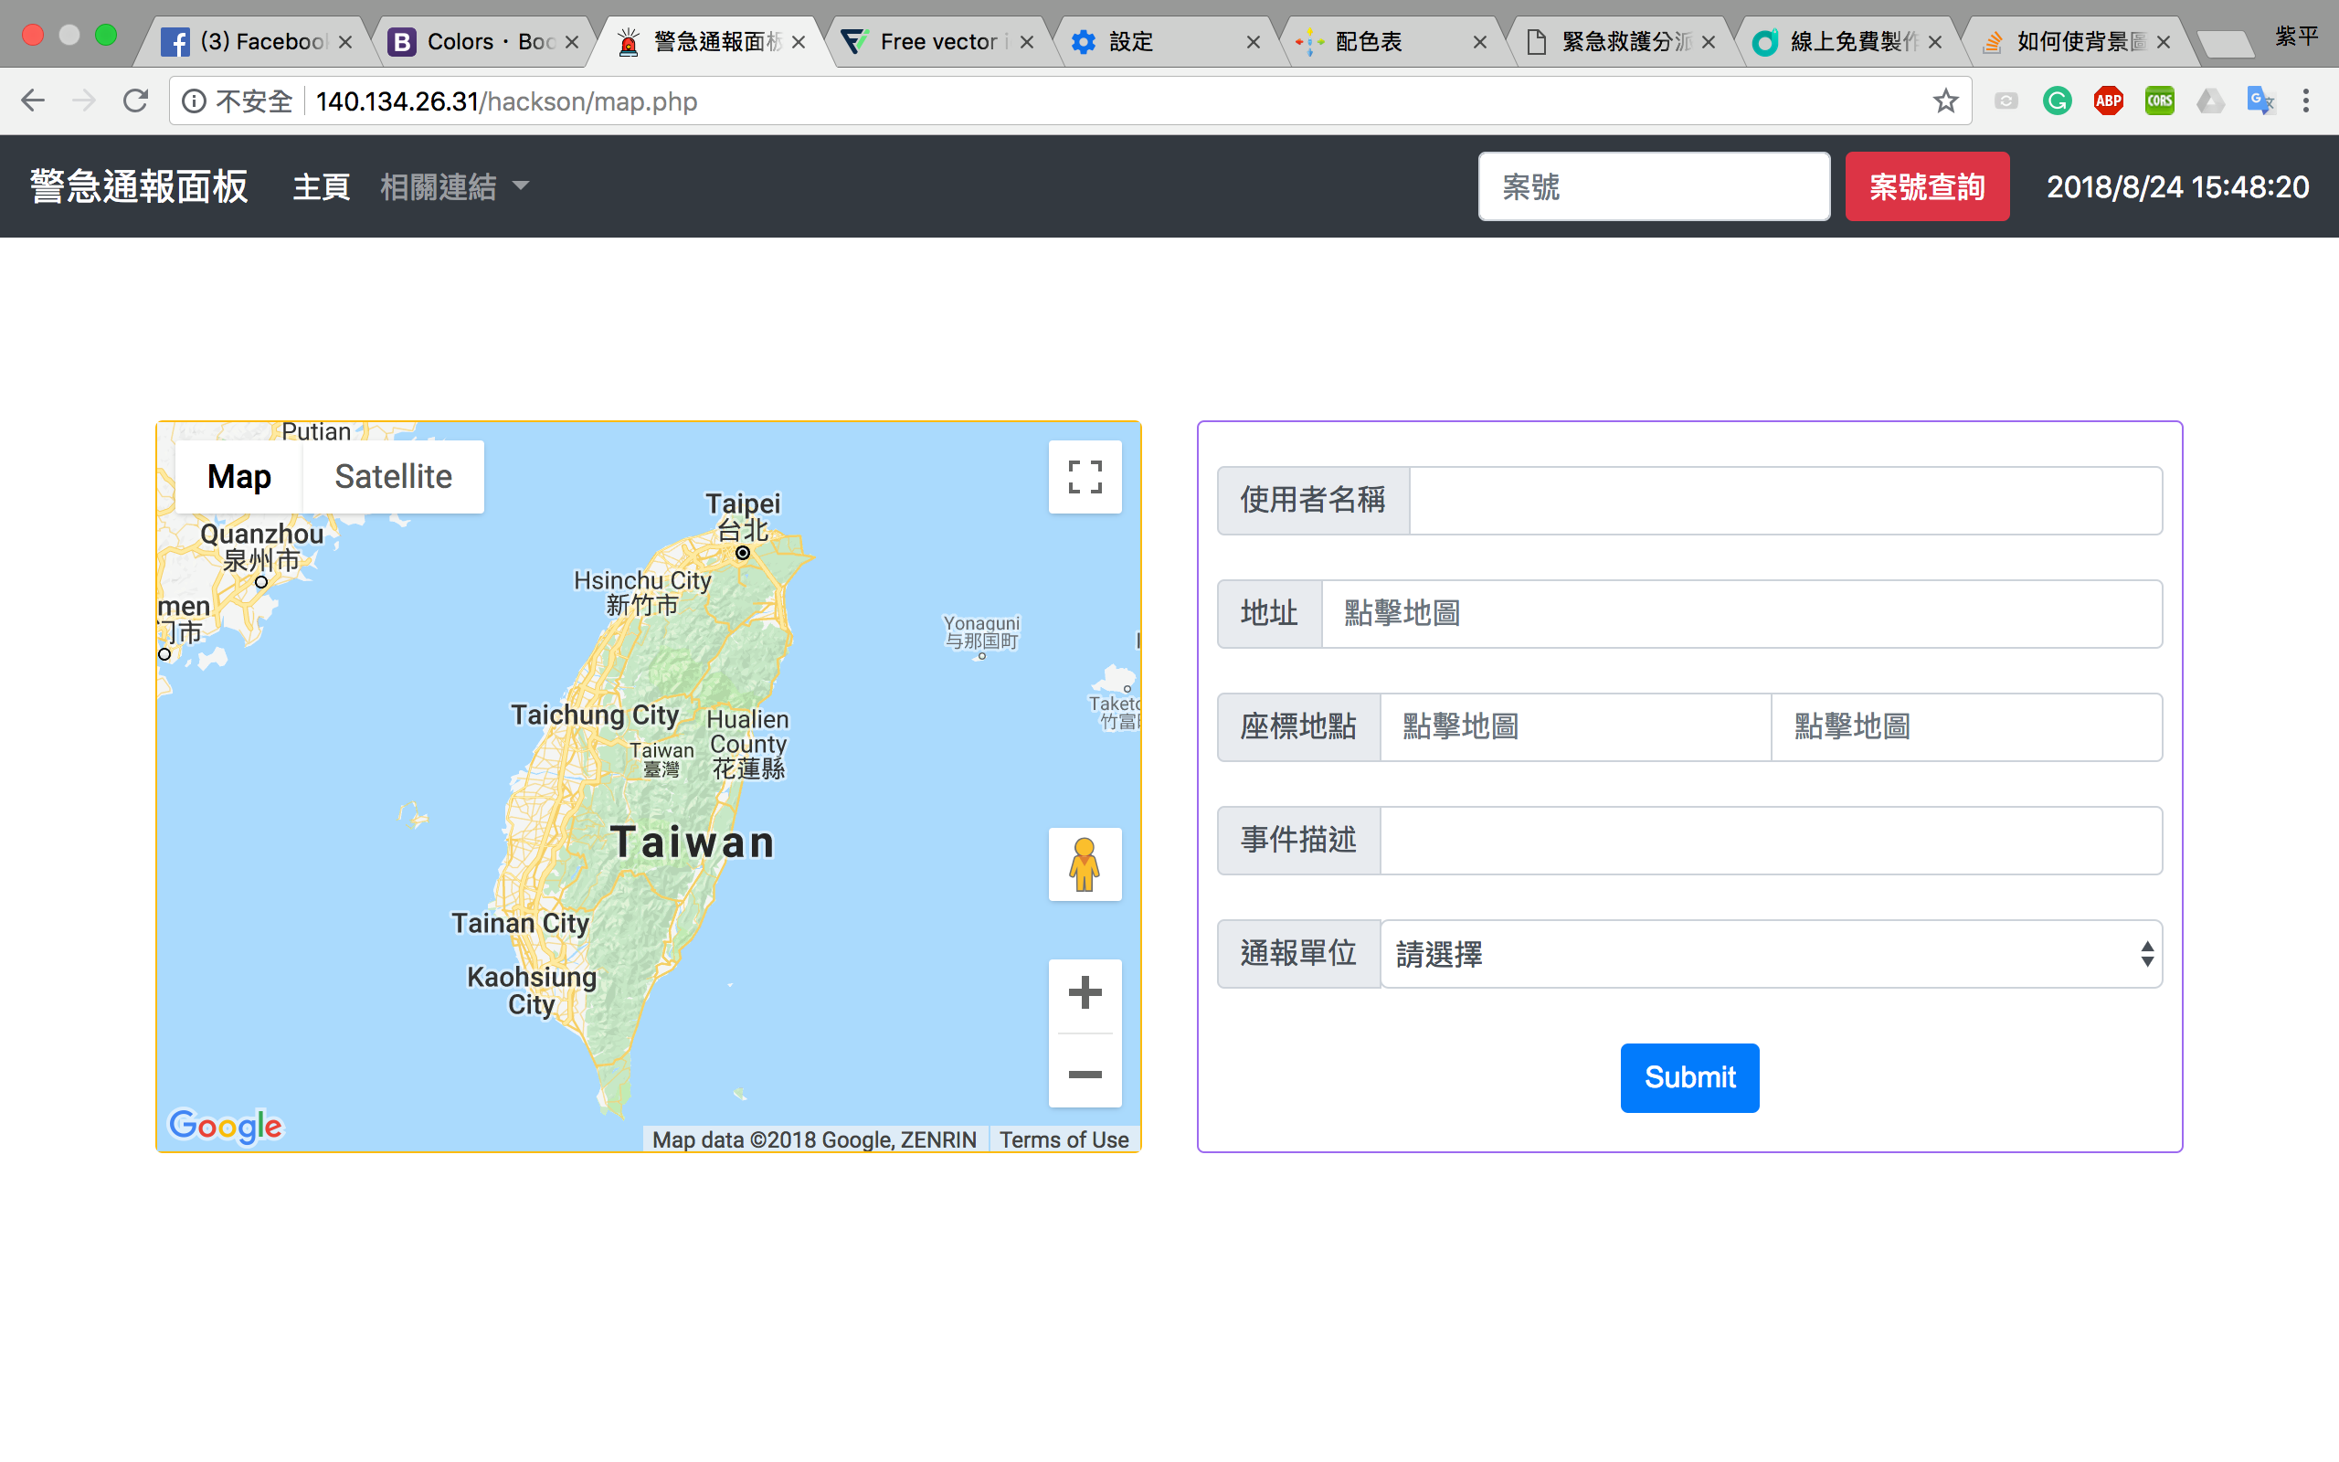
Relative organs can use the website pages connect to ANIMAP

Slide 15
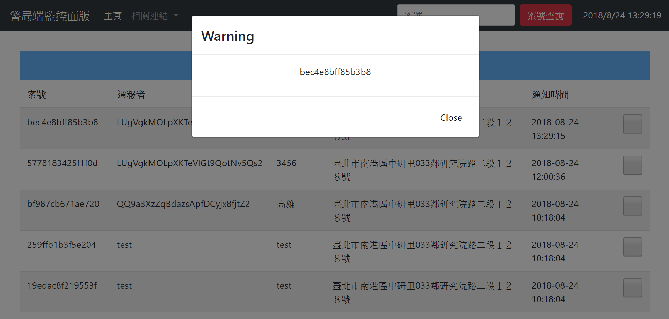
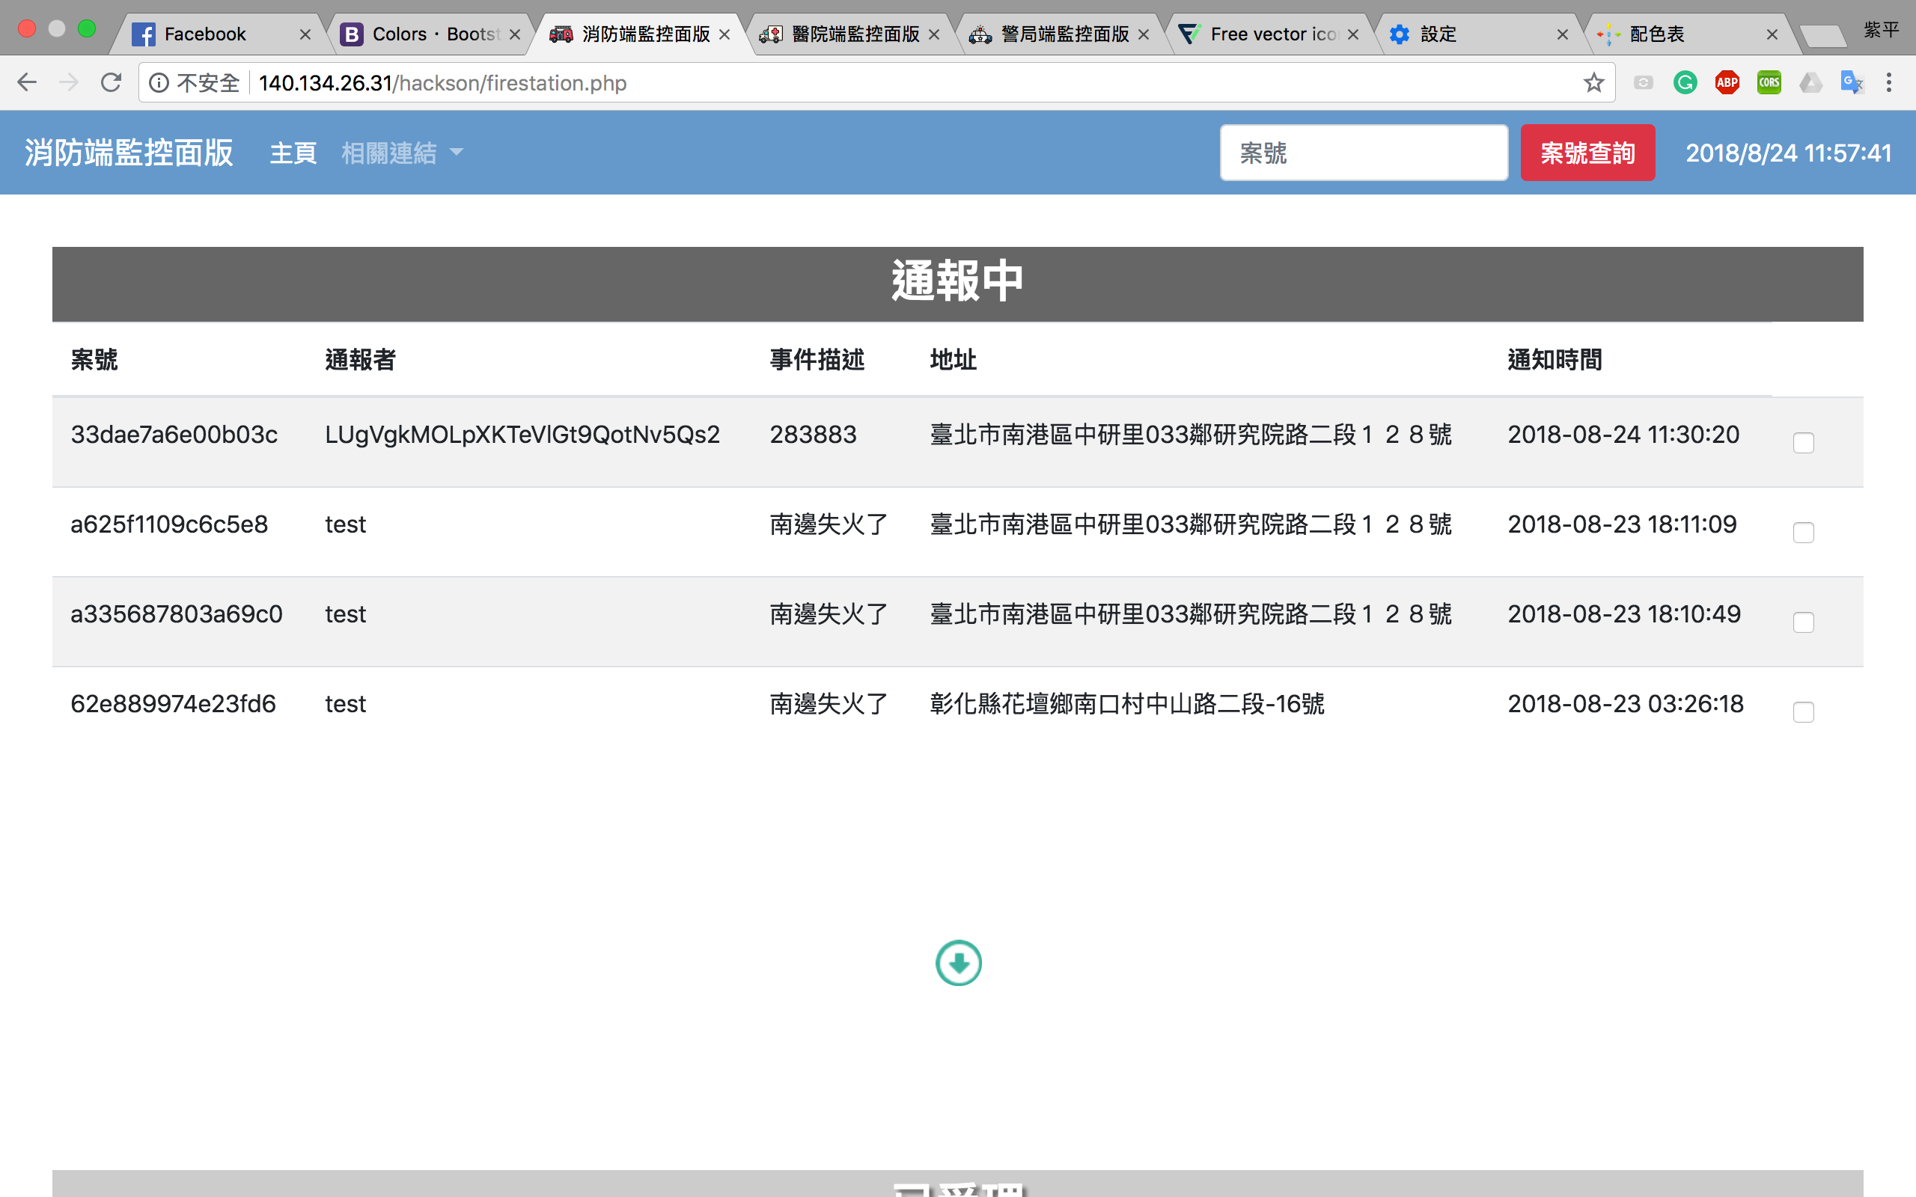
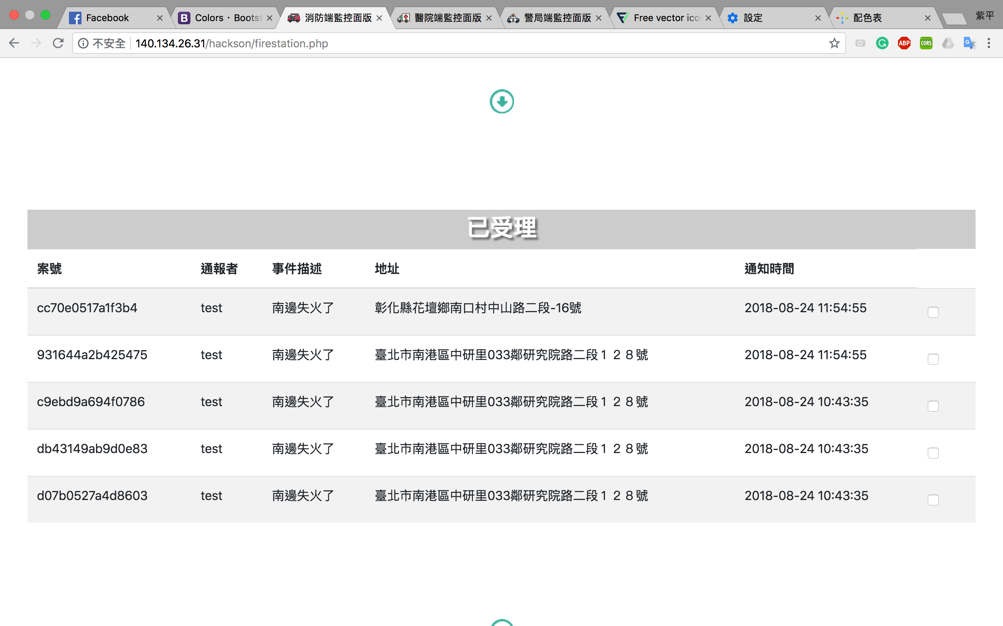
System Features
- Civilian Notification
Update the circumstance
Instant notice will connect with ANIMAP
Notes:
上傳到資料庫 可手動更改楚里狀況
User to organ

Slide 16
System Features
- Emergency Notification
事件通報
The organization can notify the users nearby the emergency area
Notes:
Organ to user

Slide 17
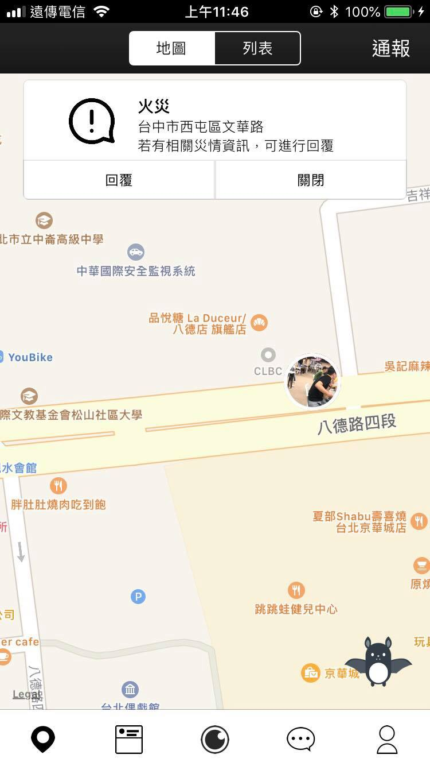
System Features
- Emergency Notification
Reply
To help organs realize the disaster’s circumstance more correctly.

Slide 18
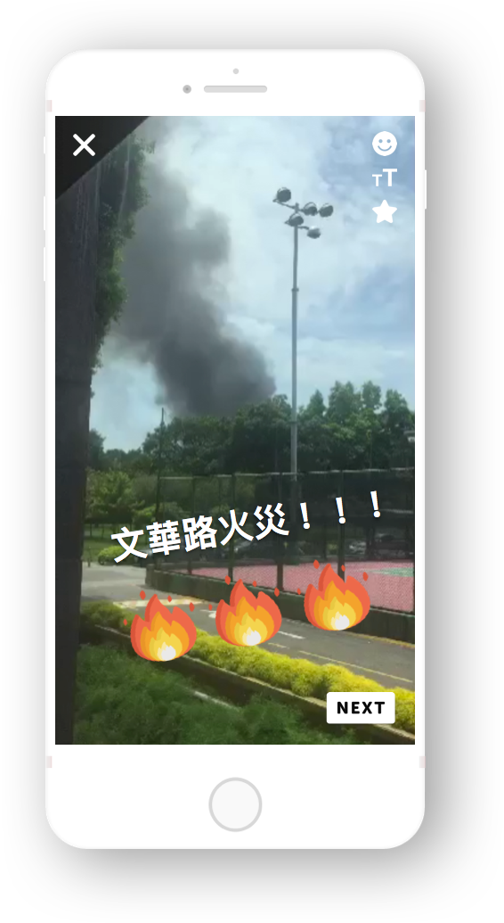
System Features
- Video Sticker Edittion
Filter x Word x Sticker
Enhance local information interaction
We can find the point of the video directly by using words and stickers

Slide 19
System Features
- Instant Video Map
Presentations：Map + List

Slide 20
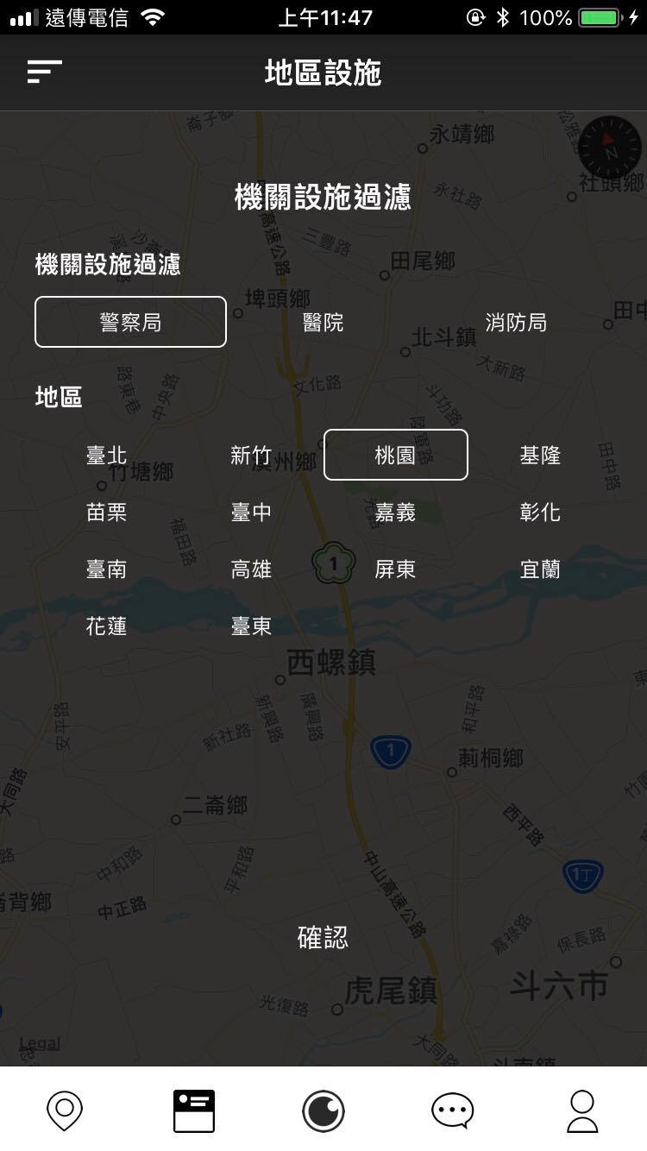
System Features
- Relative Organization
Find the nearest organization
Only show relative
Data resources：
政府開放資料平台:
救援與應變單位點位
衛生福利部評鑑合格之醫院名單
內政資料開放平台:
各縣(市)警察(分)局暨所屬分駐(派出)所地址資料
Notes:
離user

Slide 21

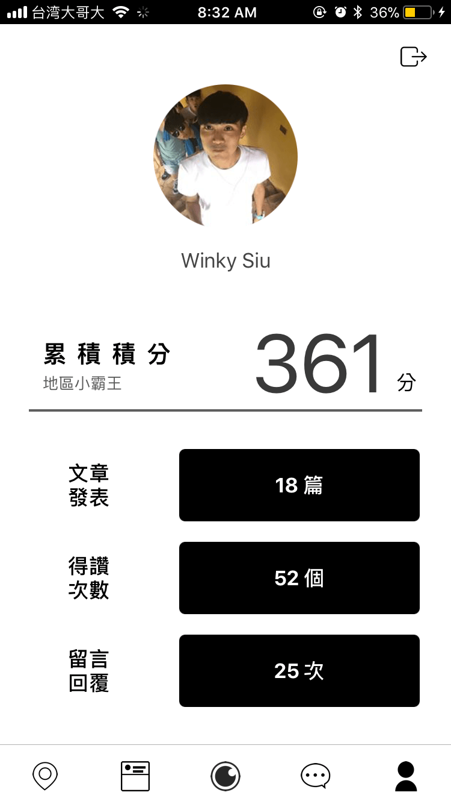
System Features
- Personal Achievement
Record your distribution for the local area
Promote the civilian to share local information intensely

Slide 22
Introduction
Nucleus Concept
System Features
Future Development

Slide 23
Future Development
Determine the disaster by the video
Create commercial value

Slide 24
Future Development
- Determine the disaster by the video
Analysis the disaster to make a correct decision ,
so that can avoid wasting resources .
影 片 判 斷 災 情
Notes:
回復功能

Slide 25



Future Development
- Create commercial value
Through analysising the flow of people and find the hot spot of the location. We can develop more commercial value .

Slide 26


Slide 27


Slide 28
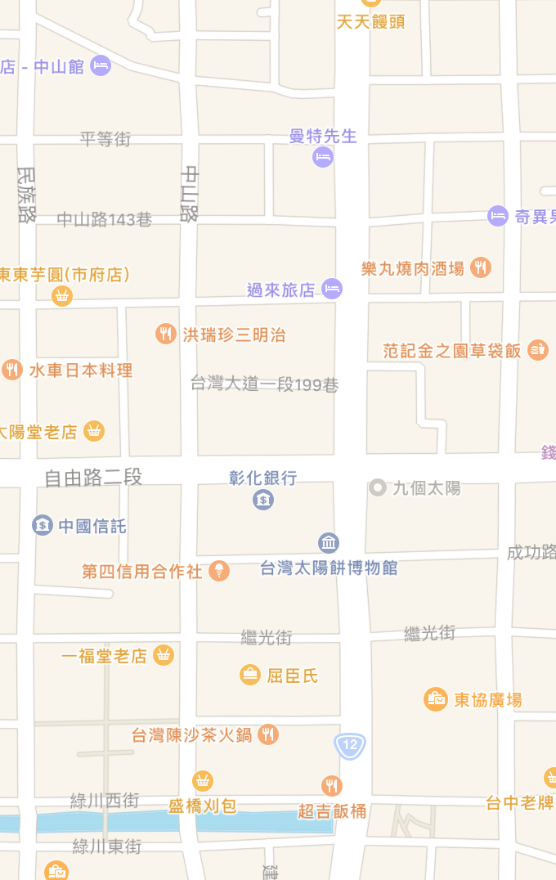
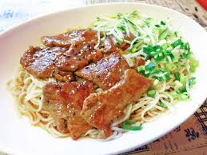
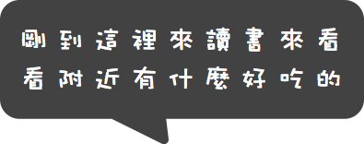
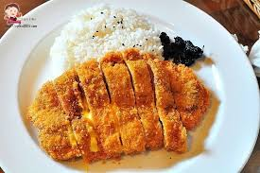

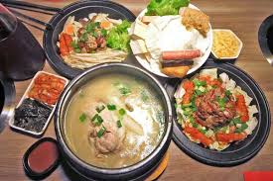

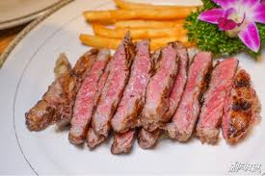
未 來 發 展
個 人 化 資 訊 推 薦
P e r s o n a l
R e c o m m e n d

